Slide 1
Tree.st E&I Demo
September 5th, 2012

Slide 2
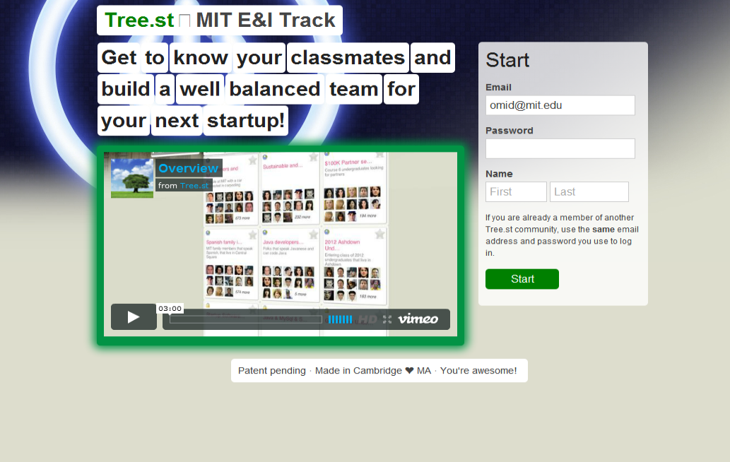

Slide 3
One Tree.st can be the member of many nested communities

Slide 4
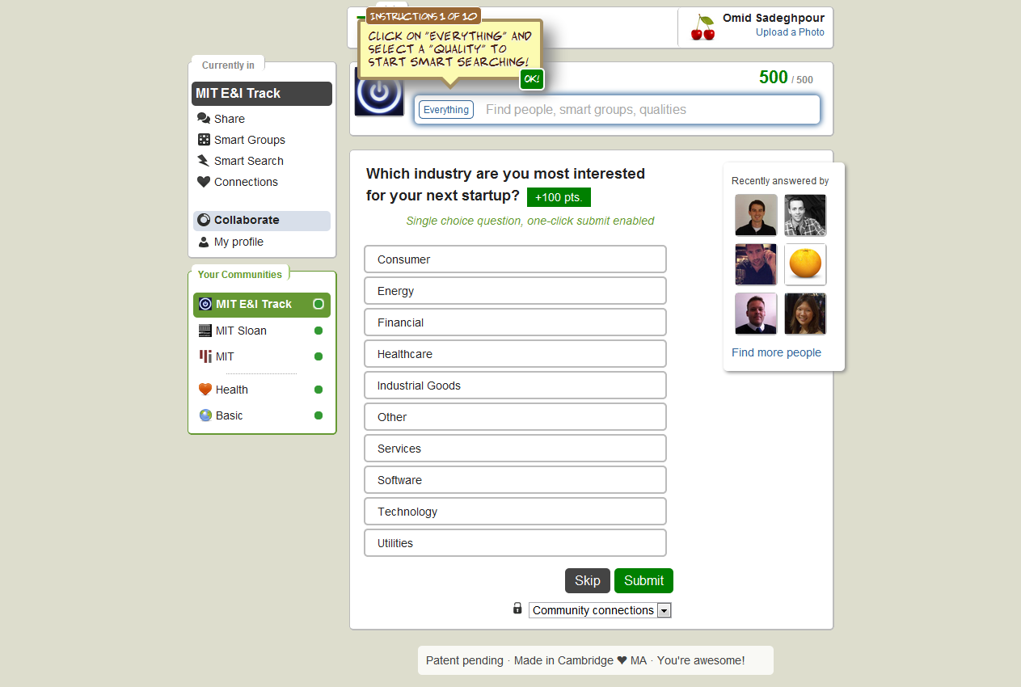

Slide 5
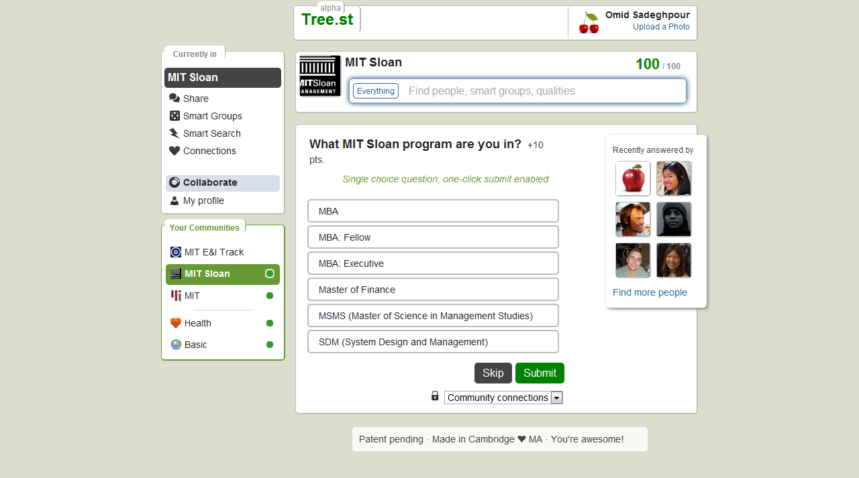

Slide 6
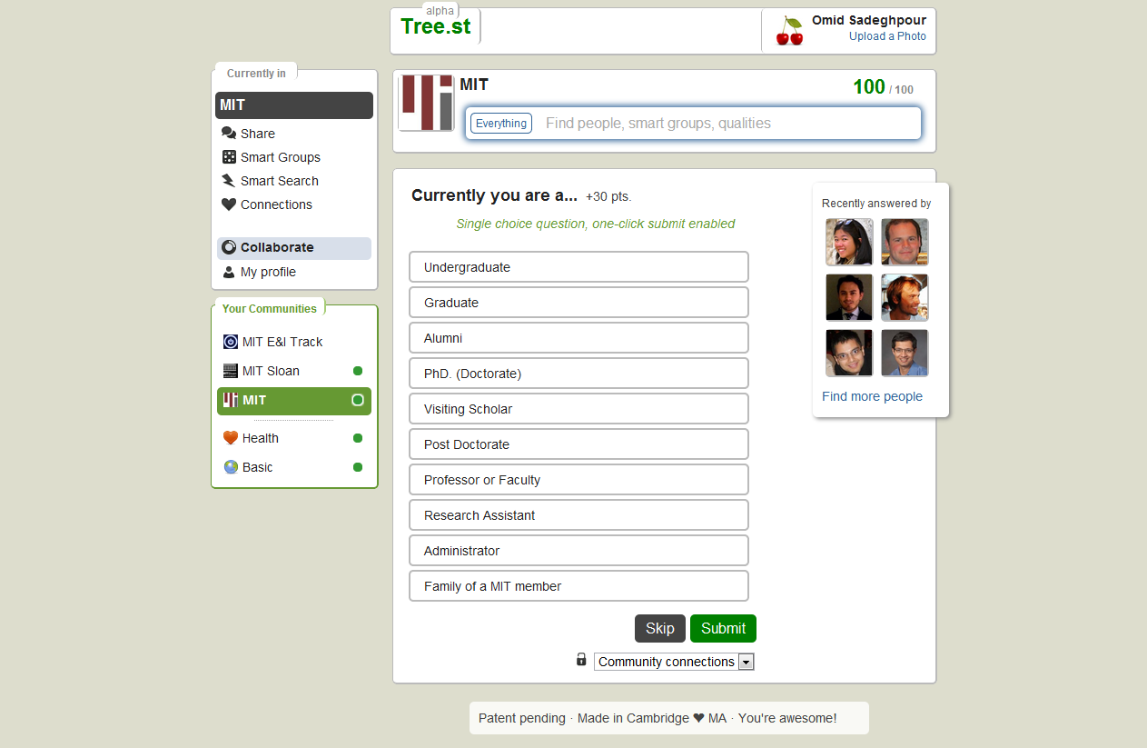

Slide 8
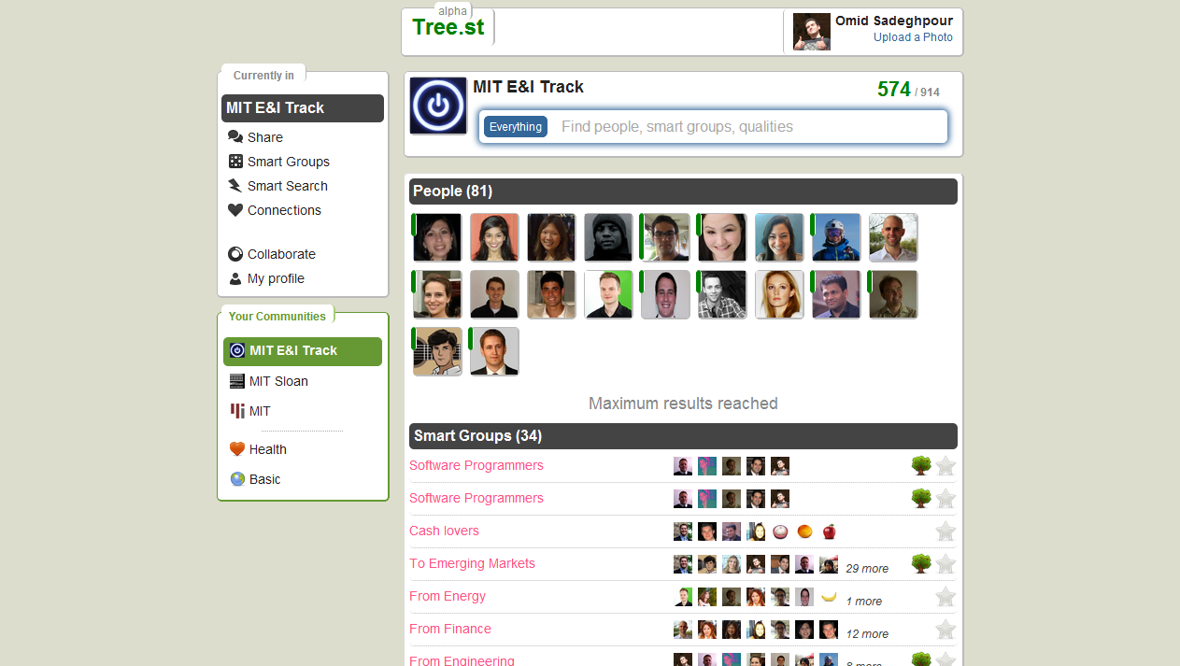

Slide 9
A Tree.st user can quickly see similarities between itself and another user

Slide 10
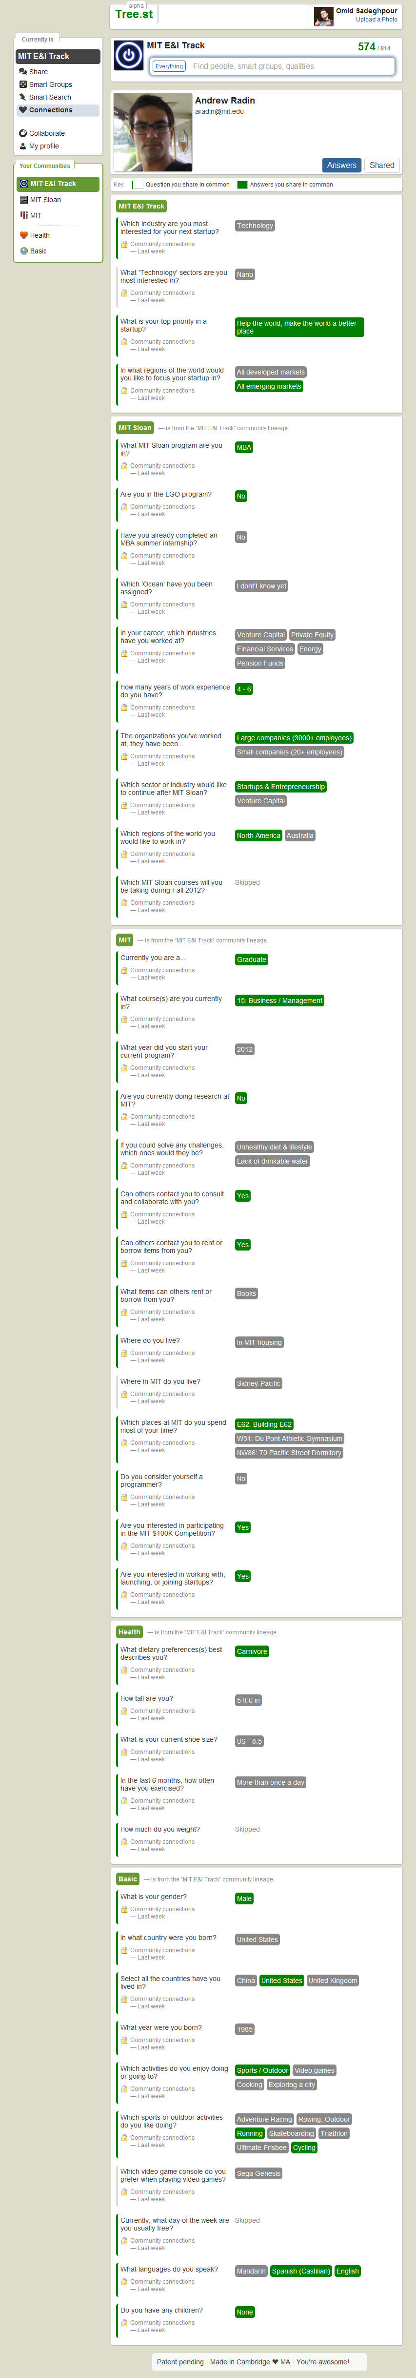
Similarities are shown in green

Slide 11
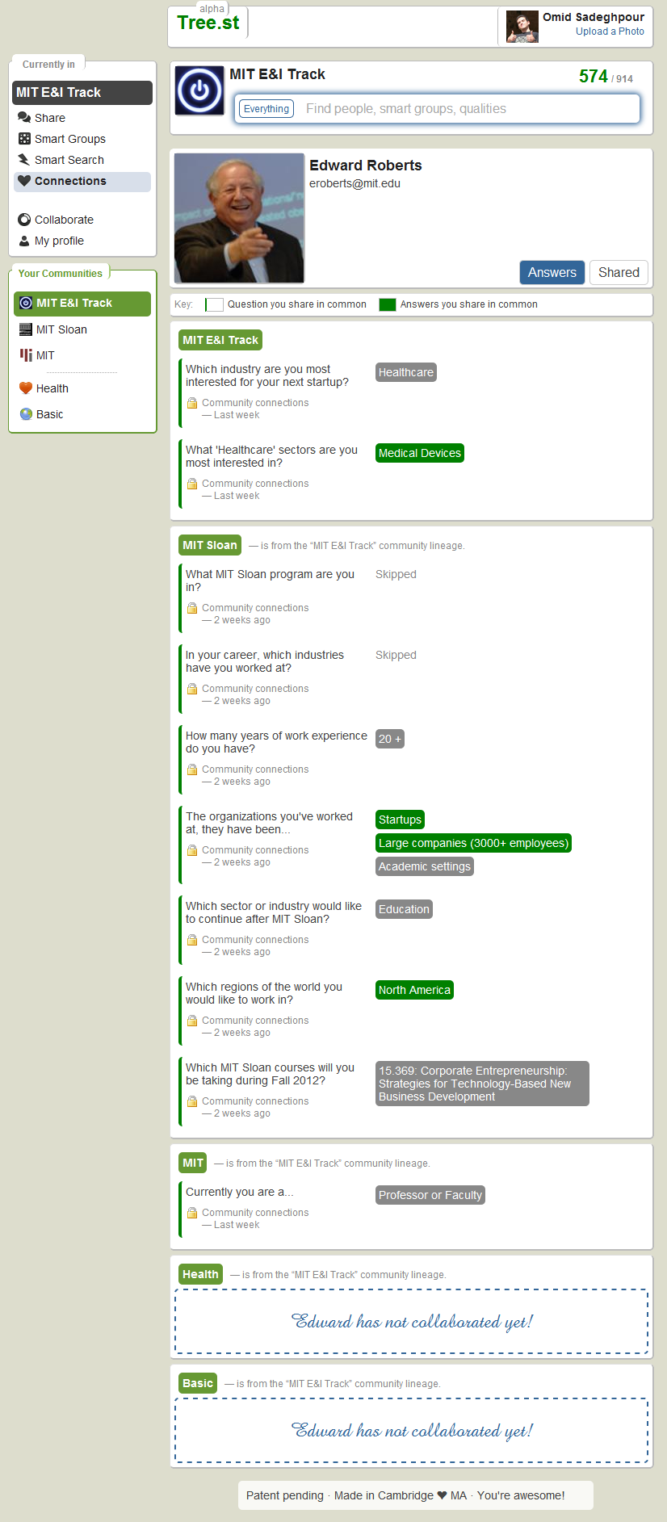
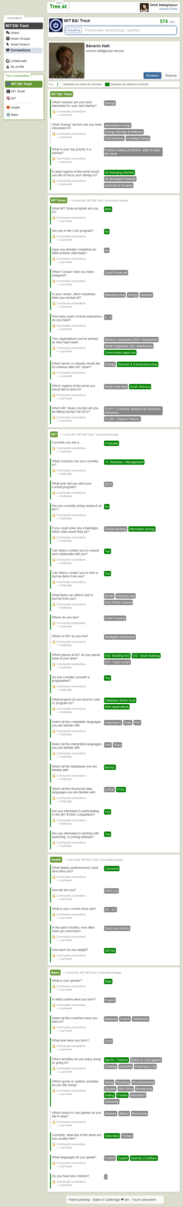
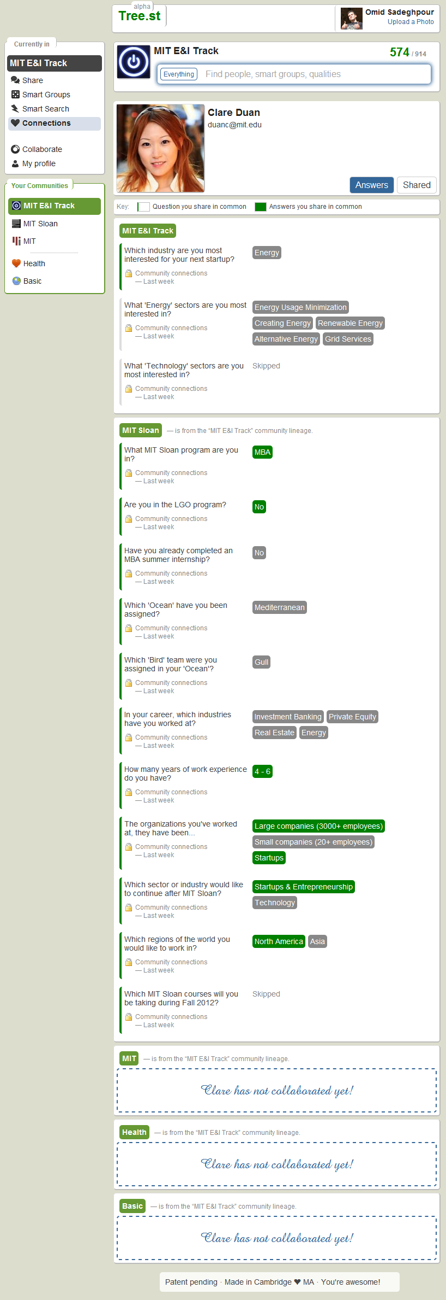

Slide 12
A Smart Search allows you quickly group people based many qualities

Slide 13
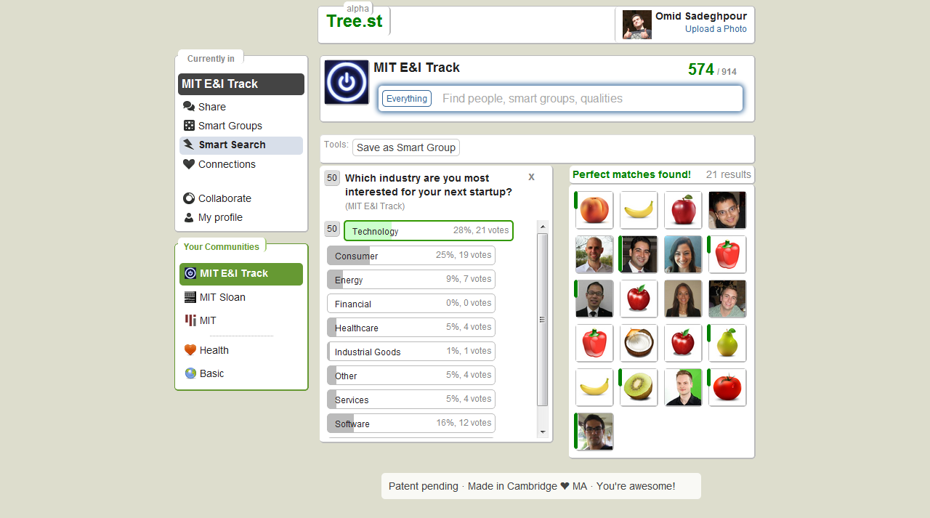

Slide 14
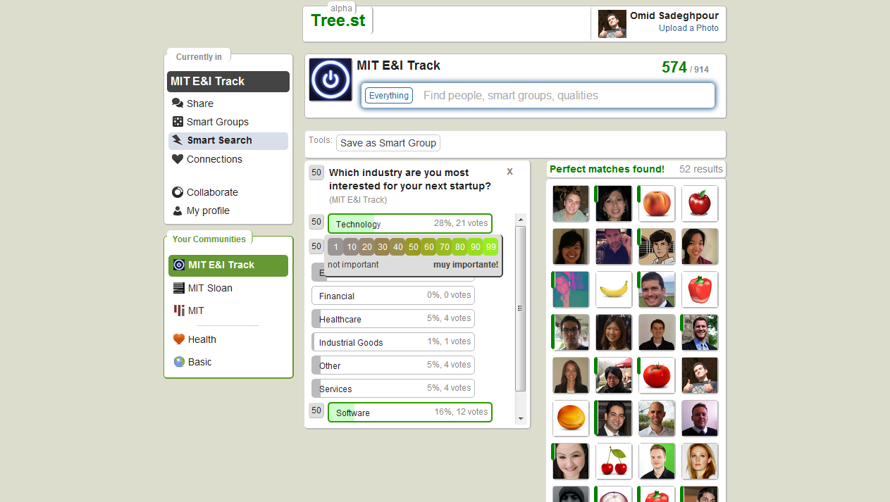

Slide 15
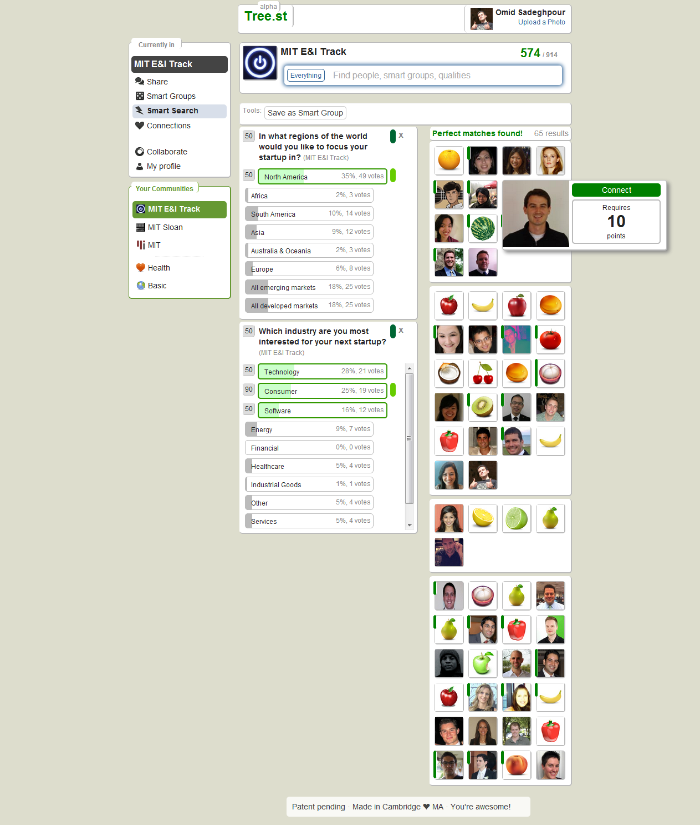

Slide 16
Any Tree.st user can create a Smart Group and share it with the community

Slide 17
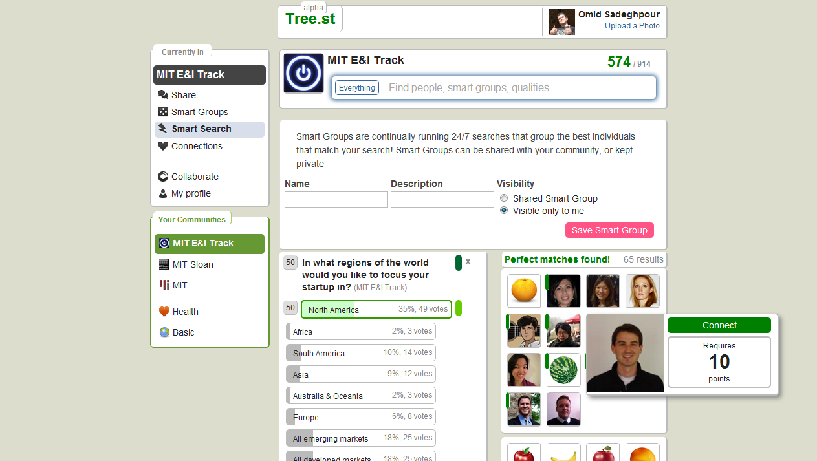

Slide 18
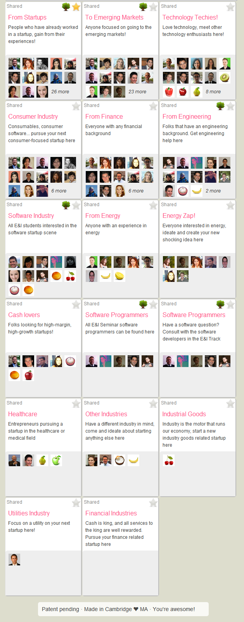

Slide 19
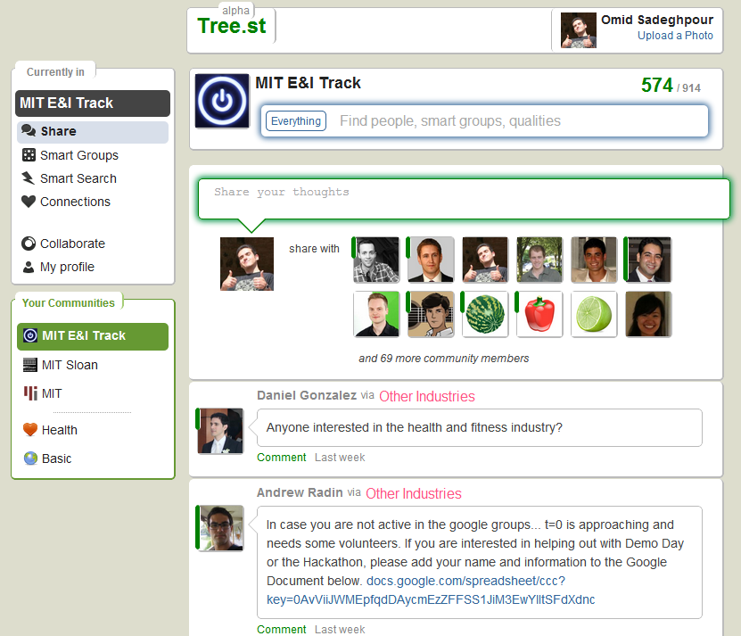

Slide 20
The idea is to have people self-organize themselves and quickly find one another for collaboration purposes. Thanks.

